Slide 1
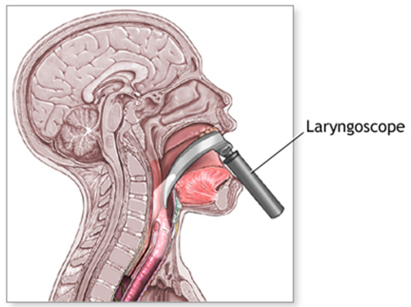
Laryngoscope
principles of operation
function
use
scientific principles
construction
components
system diagram
inputs/outputs
18.3.6 Maintain a laryngoscope
Unit C18.3 Maintaining Paediatrics Equipment
Module 279 19 C Medical Instrumentation II
©
dr. Chris R. Mol, BME, NORTEC, 2015

Slide 2
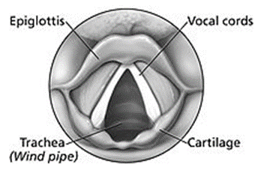
Laryngoscopy: Anatomy
Laryngoscopy (larynx + scopy) is a medical procedure that is used to obtain a view of the vocal cords and the glottis.
Larynx: the hollow muscular organ forming an air passage to the lungs and holding the vocal cords; the voice box.
Glottis: the part of the larynx consisting of the vocal cords and the slit-like opening between them. It affects voice modulation through expansion or contraction.
Vocal folds/cords: folds of membranous tissue which project inwards from the sides of the larynx to form a slit across the glottis in the throat, and whose edges vibrate in the airstream to produce the voice.
Adult male voices are usually lower pitched due to longer and thicker folds. The male vocal folds are between 1.75 cm and 2.5 cm in length, while female vocal folds are between 1.25 cm and 1.75 cm in length. The vocal cords of children are much shorter than those of adult males and females.
©
Laryngoscope
dr. Chris R. Mol, BME, NORTEC, 2015

Slide 3
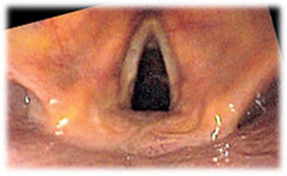
Function
Laryngoscopy may be performed:
to facilitate tracheal intubation during general anesthesia or cardio-pulmonary resuscitation
to execute procedures on the larynx or other parts of the upper trachea-bronchial tree, for example biopsies.
View of the glottis as seen during laryngoscopy
©
Laryngoscope
dr. Chris R. Mol, BME, NORTEC, 2015

Slide 4
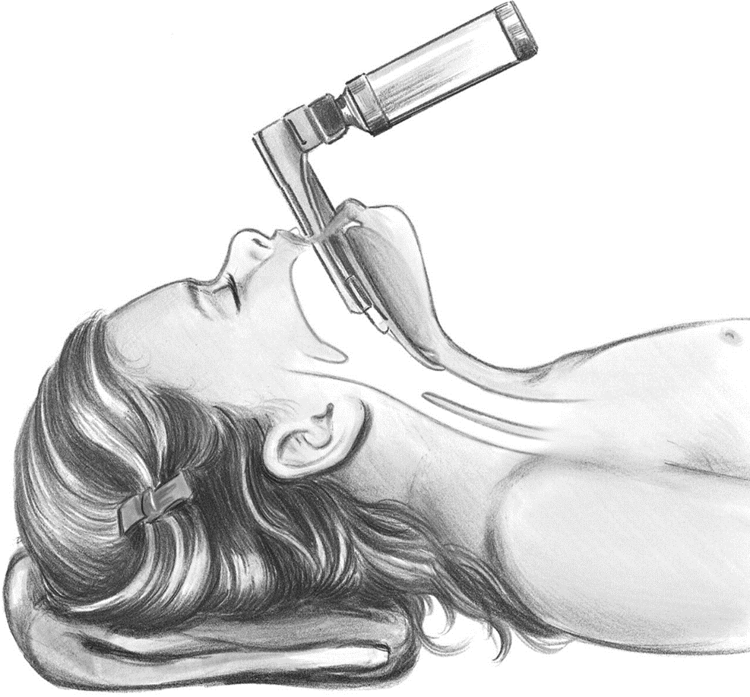
Conventional ‘direct’ laryngoscopy
Conventional ‘direct’ laryngoscopy is carried out with the patient lying on his or her back; the laryngoscope is inserted into the mouth on the right side and flipped to the left to trap and move the tongue out of the line of sight, and, depending on the type of blade used, inserted either anterior or posterior to the epiglottis and then lifted with an upwards and forward motion. This move makes a view of the glottis possible.
The procedure is done in an operation theatre with full preparation for resuscitative measures to deal with respiratory distress. It is extremely uncomfortable and is not typically performed on conscious patients, or on patients with an intact gag reflex.
Direct laryngoscopy provides a direct, straight view, (without mirrors or fiber optics or so), made possible by a rigid viewing instrument with a light on the blade or intra-oral portion. The procedure gives a direct view of the targeted larynx in 80-90% of attempts.
©
Laryngoscope
dr. Chris R. Mol, BME, NORTEC, 2015

Slide 5
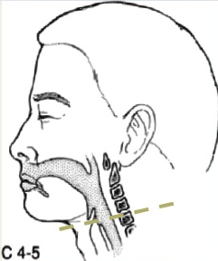
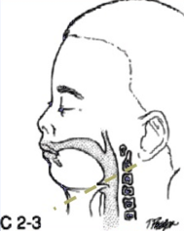
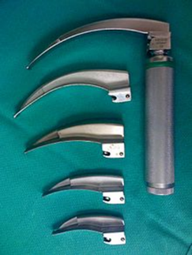
Different models for children
The conventional laryngoscope consists of a handle containing batteries with a light source, and a set of interchangeable blades
The pediatric airway differs from adult airways.
For example, the larynx in children is positioned higher in the neck. At birth the larynx is at the level of the third cervical vertebra. By adulthood it is at the level of the fifth vertebra.
Therefore, specially shaped laryngoscopes are used for children.
Laryngoscope handle with an assortment of Miller blades
©
Laryngoscope
dr. Chris R. Mol, BME, NORTEC, 2015

Slide 6
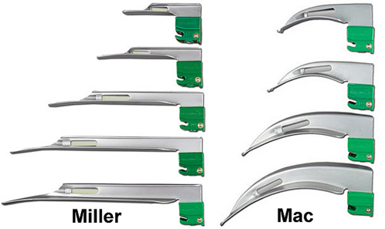
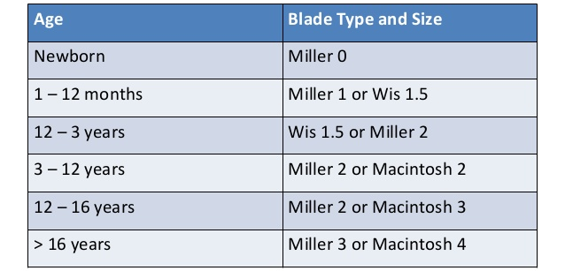
Different models
Two basic styles of laryngoscope blade are currently commercially available:
the curved blade such as the Mac (or Macintosh) blade
the straight blade such as the Miller blade
Both Miller and Macintosh laryngoscope blades are available in sizes 0 (neonatal) through 4 (large adult).
©
Laryngoscope
dr. Chris R. Mol, BME, NORTEC, 2015

Slide 7
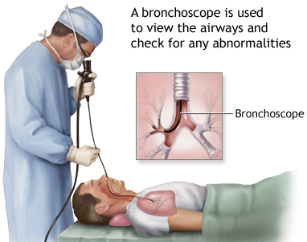
‘Indirect’ fiber-optic Laryngoscope
‘Indirect’ fiber-optic viewing laryngoscopes include the flexible fiber-optic bronchoscope. This can be used for office-based diagnostics or for tracheal intubation. The patient can remain conscious during the procedure, so that the vocal folds can be observed during phonation (while making a sound). Surgical instruments passed through the scope can be used to perform procedures such as biopsies of suspicious masses.
©
Laryngoscope
dr. Chris R. Mol, BME, NORTEC, 2015

Slide 8
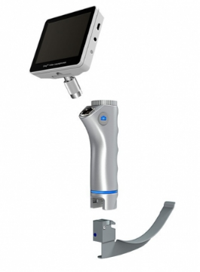
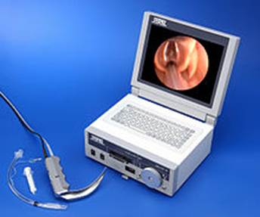
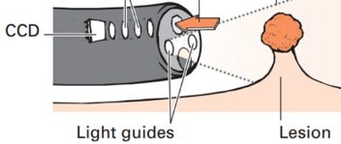
Video (and fiber optic) Laryngoscope
The digital era has brought video laryngoscopes which employ a digital image sensor (CCD or CMOS technology) to generate a view of the glottis which can be seen on a monitor.
(see also the ‘Endoscopy system’ in Instrumentation I).
©
Laryngoscope
dr. Chris R. Mol, BME, NORTEC, 2015

Slide 9
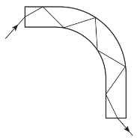
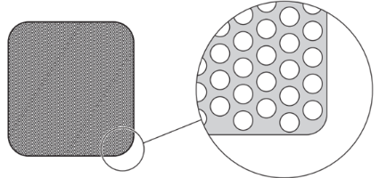
Scientific Principles: fiber optics
Fiber-optic instruments are based on optical viewing bundles. The viewing bundle of a standard fiber-endoscope is 2–3 mm in diameter and contains 20·000–40·000 fine glass fibers, each close to 10 µm in diameter.
Light focused onto the face of each fiber is transmitted by repeated internal reflections (Figure). Each individual glass fiber is coated with glass of a lower optical density to prevent leakage of light from within the fiber, since the coating does not transmit light (mirror).
The image quality of a fiber optic bundle is excellent but can never equal that of a rigid lens system. However, fiber optic bundles are extremely flexible, and an image can be transmitted even when the bundle is tied in a knot.
total internal reflection of light down a glass fiber
fiber bundle showing the packing of fibers
Endoscopy system
dr. Chris R. Mol, BME, NORTEC, 2015

Slide 10
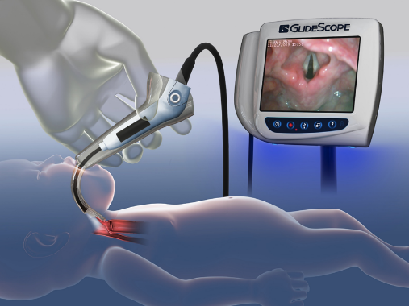
Illumination
Lighting is crucial; it is not always sufficiently described by light strength (in units of ‘lux’). Factors such as light distribution also need to be considered. The brightest light is not always the best. Most anaesthetists prefer the degree of illumination to be less than 700 lux .
Some anaesthetists have expressed a preference for blue/white light. Blue light corresponds to peak haemoglobin absorption (415nm). Most conventional laryngoscopes have an incandescent light bulb that produces a yellow light.
Light Emitting Diodes (LEDs) are a light source in blue/green region of the spectrum (400–550 nm); they use less energy and last longer than the standard bulb.
©
Laryngoscope
dr. Chris R. Mol, BME, NORTEC, 2015

Slide 11
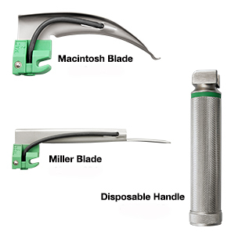
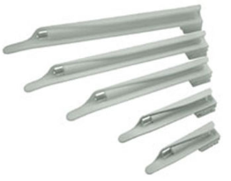
Disposable blades
Traditional cleaning and (autoclave) sterilisation of re-usable equipment is effective against bacterial contamination but is costly. It may also affect laryngoscope performance. This has led to a massive investment in disposable laryngoscopes.
Many different manufacturers produce disposable Miller blades, but these vary widely in blade flexibility, brightness of the light and in the angle and direction of the light emitted.
disposable blades and handle
©
Laryngoscope
dr. Chris R. Mol, BME, NORTEC, 2015

Slide 12
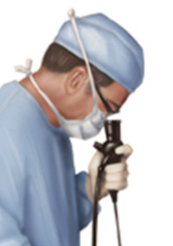
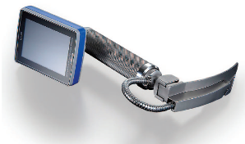
Summary: different types of Laryngoscope
Fibre optic laryngoscope with lamp and a lens at the end of the fiber optic cable. The image is viewed without electronic magnification.
Video (fibre optic) laryngoscope. The image sensor is inside the body, Display is on a small monitor screen. Battery operated.
Video (fibre optic) laryngoscope with stand- alone large monitor viewing and image processing and storage.
direct laryngoscope with lamp, viewed directly by the human eye.
©
Laryngoscope
dr. Chris R. Mol, BME, NORTEC, 2015

Slide 13
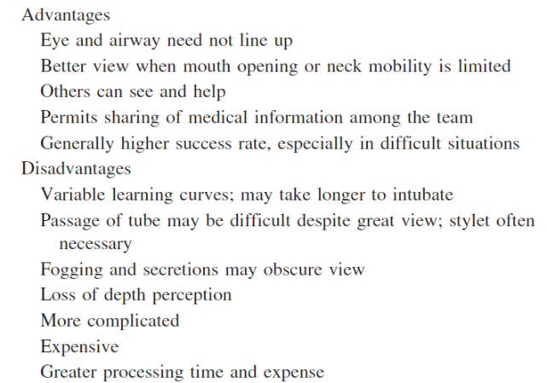
(Dis)Advantages of video Laryngoscopy
©
Laryngoscope
dr. Chris R. Mol, BME, NORTEC, 2015

Slide 14
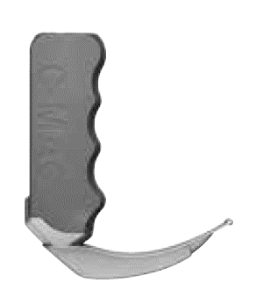
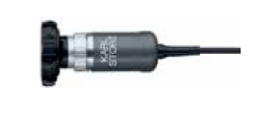
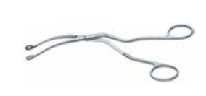
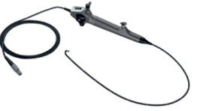
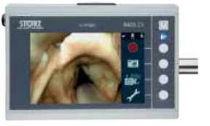
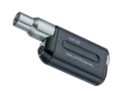
Components
intubation endoscope
camera head
for external placement
video laryngoscope
forceps to remove foreign bodies from throat
flexible intubation video endoscopy set, with CMOS and suction valve
battery / light source
small monitor
©
Laryngoscope
dr. Chris R. Mol, BME, NORTEC, 2015

Slide 15
END
The creation of this presentation was supported by a grant from THET:
see https://www.thet.org/

